Slide 1

Facial Expression
Recognition
Implementation and Comparison with the Paper
“Facial Image Expression Recognition and Prediction System”
Juan Sebastian Sarmiento Pulido
Numerical Analysis for Machine Learning • May 2026
Notes:
Welcome everyone. Today I'll present my project on Facial Expression Recognition, where I implemented and compared several models with the reference paper 'Facial Image Expression Recognition and Prediction System'. This work was done for the Numerical Analysis for Machine Learning course at Politecnico di Milano.

Slide 2
MOTIVATION & PROBLEM STATEMENT
Goal
Key Challenges
Classify facial images into 7 basic emotions:
Noisy & mislabeled images
Severe class imbalance
Similar facial expressions across emotions
Illumination, pose & subject variation
Anger
Disgust
Fear
Happy
Sad
Surprise
Neutral
Why is this hard?
Facial expressions are inherently ambiguous (subject-specific differences), the same emotion can look different across individuals, and different emotions can produce similar facial configurations. This makes automatic recognition a challenging classification problem (Almost an idealization).
2 / 15
Notes:
Facial expression recognition aims to classify facial images into seven basic emotions. The task is challenging due to noisy images, class imbalance (e.g., Happy is overrepresented while Disgust is underrepresented), similar-looking expressions, and variations in illumination, pose, and individual differences.

Slide 3
REFERENCE PAPER & PROJECT GOAL
Reference Paper Methodology
Our Project Goal
Data preprocessing & cleaning
PCA for dimensionality reduction
SVM classifier (baseline)
VGG / CNN model
Sequential CNN + hypothesis testing
Replicate the reference paper's pipeline
Refine with explicit cleaning, tuning, and train/val/test split
Compare three model families on FER-2013 dataset
Evaluate using comprehensive metrics and learning curves
3 / 15
Notes:
The reference paper follows a pipeline of data preprocessing, PCA, SVM, VGG/CNN, and sequential CNN with hypothesis testing, evaluated using standard classification metrics. Our project replicates this pipeline, refines it with more explicit data cleaning and hyperparameter tuning, and compares the three model families on the FER-2013 dataset.

Slide 4
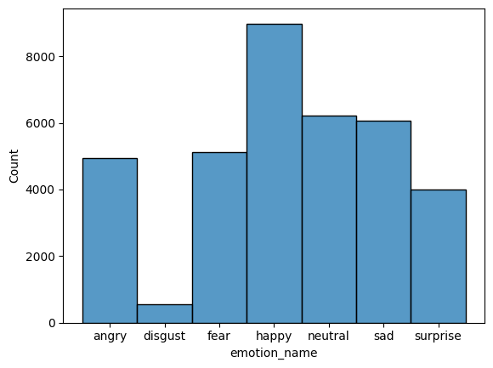
FER-2013 DATASET
35,904
48×48 px
Grayscale
7
Total Images
Resolution
Color Space
Classes
Class Imbalance
Happy is heavily overrepresented (8,990 samples)
Disgust is severely underrepresented (547 samples)
This imbalance affects model training and evaluation
4 / 15
Notes:
The FER-2013 dataset contains 35,887 grayscale 48x48 images across seven emotion classes. There is significant class imbalance: Happy has nearly 9,000 samples while Disgust has only 547. This imbalance affects model training and particularly impacts macro-averaged performance metrics.

Slide 5
DATA PREPROCESSING PIPELINE
1
→
2
→
3
→
4
→
5
→
6
Load
Resize
Encode
Split
Clean
Model
Raw FER-2013
image folders
Normalize to
[0, 1] range
Label encoding
& one-hot
Stratified
train/val/test
Remove noisy
& blank images
PCA→SVM or
CNN input
FER-2013 Folder structure and File Lecture
Pixel value color normalize to improve model learning
Label identification and encoding to avoid expression hierarchy
Split test set (FER 2013 structure) in a half stratified
Image manipulation and “blank images” recognition
5 / 15
Notes:
The preprocessing pipeline starts with loading raw FER-2013 images, then resizing and normalizing pixel values to [0,1]. Labels are encoded using label encoding and one-hot encoding. We use a stratified train/validation/test split. Noisy and blank images are cleaned, and features are prepared either via PCA for SVM or as direct inputs for CNN models.

Slide 6
DATA CLEANING STRATEGY
Cleaning Approach
53
Automated pixel-based metrics
• Mean pixel intensity thresholds
• Black-pixel and white-pixel count
• Edge detection for non-face images
Manual inspection
• Visual review of flagged images
noisy images
removed
Blank, noisy, or non-human face images that would mislead model training
Examples of Discarded Images
Nearly blank
(low intensity)
Over-exposed
(high white count)
Non-face image
(edge artifacts)
Heavily occluded
(unrecognizable)
6 / 15
Notes:
We cleaned the dataset by combining automated pixel-based metrics (mean intensity, black/white pixel counts) with manual inspection. 53 noisy images were removed, including blank images, over-exposed samples, non-face images, and heavily occluded faces. This step improves dataset reliability for model training.

Slide 7
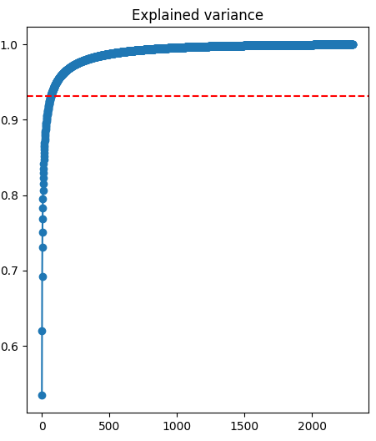
PCA & FEATURE REPRESENTATION
Principal Component Analysis
Explained Variance by Component
Dimensionality reduction
From 48×48 images , to 2304 features. And then to PCA projects to lower dimensions
Used primarily for SVM pipeline
Follows the reference paper's classical ML approach
Limitation
Can lose spatial information critical for subtle differences
For ~200 components onwards, the information lost is minimal. However, 67 components retain 86% of the total variance of the 2304 original features.
7 / 15
Notes:
PCA reduces the 2304-dimensional flattened images to a lower-dimensional space. Around 200-300 components retain 85-91% of variance. However, the flattening step destroys spatial relationships, which is why CNNs that preserve this information tend to perform better.

Slide 8
MODEL EVALUATION METHODOLOGY
1
2
3
4
5
Cleaned
Dataset
→
Train on
Training Set
→
Tune on
Validation
→
Evaluate
on Test
→
Compare
Models
Normalized input
Learn patterns
Hyperparameters
Final metrics
Unified metrics
Comparison Metrics
Accuracy
Macro Precision
Macro Recall
Overall correct predictions
Average precision per class
Average recall per class
Macro F1-Score
Confusion Matrix
Learning Curves
Harmonic mean of P & R
Per-class error analysis
Training dynamics
8 / 15
Notes:
All three models follow the same evaluation methodology: train on the cleaned training set, tune using validation performance, evaluate on the test set, and compare using accuracy, macro precision, macro recall, macro F1-score, confusion matrices, and learning curves.

Slide 9
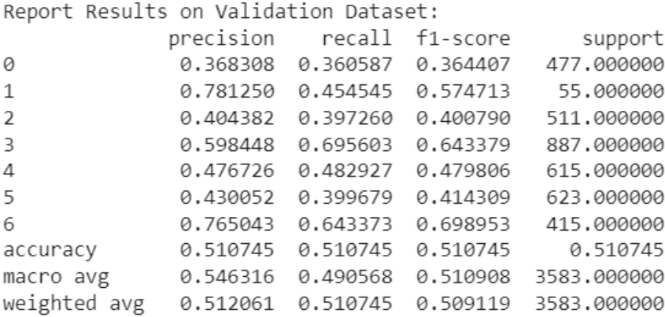
MODEL 1: SVM WITH PCA FEATURES
Follows the reference paper's classical ML baseline. Tests whether PCA-reduced features are sufficient for emotion classification. Simple approach to have a baseline to compare learning capacity of more complex models.
Hyperparameters
Polynomial , Radia basis and Gaussian Kernel
Regularization parameter for L2: 6.3
Gamma parameter (Gaussian): 0.015
Confusion Matrix (Simplified)
Results Summary
Angry
Strengths
• Interpretable, lightweight, fast
• Disgust & Surprise easier to classify
Weaknesses
• Limited generalization
• Visually similar classes confused
• Spatial relation lost by PCA
Disgust
Fear
Happy
Neutral
Sad
Surprise
9 / 15
Notes:
The SVM with PCA features follows the reference paper's classical ML baseline. We project images using PCA, then train an SVC with a Gaussian/RBF kernel, tuning C and gamma using validation F1-score. Happy and Surprise are easier to classify, but visually similar or underrepresented classes remain challenging.

Slide 10
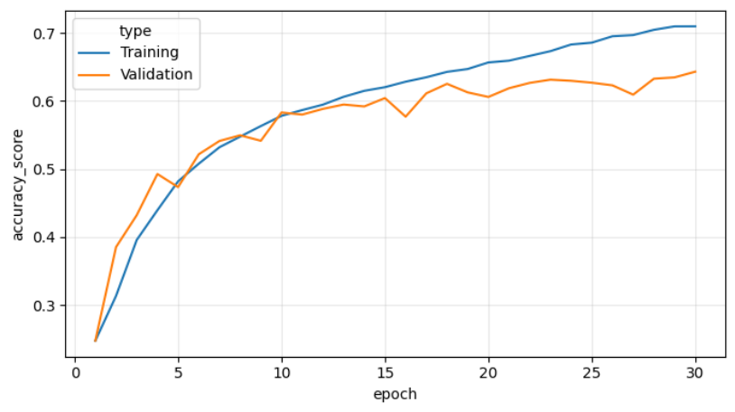
MODEL 2: VGG19-LIKE CNN
Architecture
CNNs preserve spatial information and learn hierarchical features, better suited to facial images compared to PCA and SVM.
VGG19-inspired conv blocks (from scratch)
He-normal init + ReLU + Dropout
Data augmentation
Accuracy evolution
Best Performing Model
Design Decisions
• Simplified vs full VGG19 for cost
• No pretrained weights
• Tested augmentation levels (Strong / Medium / Low / Nothing)
Result
• Strongest predictive performance
• Best generalization across classes
• Learns spatial patterns directly
10 / 15
Notes:
The VGG19-like CNN preserves spatial information and automatically learns hierarchical visual features. It was implemented from scratch without pretrained weights. This model achieved the strongest predictive performance and best generalization among all implemented models.

Slide 11
MODEL 3: SEQUENTIAL CNN & HYPOTHESIS TESTING
Is there a way to validate the effectiveness of Model 2 based on CNN? A more complex model could improve accuracy?
Approach
Findings
Sequential CNN architecture
Simpler than VGG19 / Pretrained CNN
Hypothesis testing framework
H₀: There is no difference between the features extracted from the dataset and the features extracted from a reference set
H₁: There is difference between each the feature distributions associated with different face ex-pressions.
Class confusion analysis
Evaluation of dependency between similar expressions
Did NOT outperform VGG19-like CNN
• Stronger overfitting observed
• H₁ not supported
Useful for analysis
• Visualized class confusion patterns
• Confirmed fear/sadness systematically confused
11 / 15
Notes:
The Sequential CNN follows the reference paper's hypothesis-testing idea. Results showed stronger overfitting and no improvement over the VGG19-like CNN, so H1 was not supported. However, the model was useful for analyzing class confusion patterns.

Slide 12
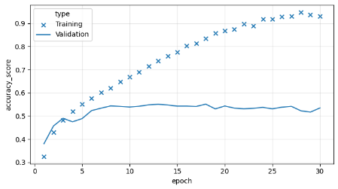
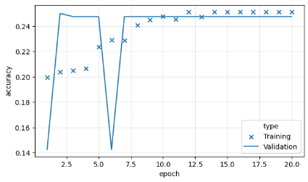
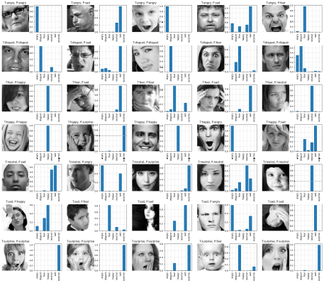
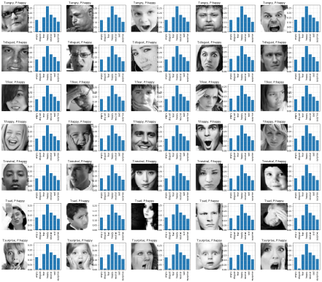
MODEL 3: HYPOTHESIS TESTING
Sequential CNN
Pretrained VGG19
Approach
Sequential CNN architecture
Simpler than VGG19 / Pretrained CNN
Findings
Did NOT outperform VGG19-like CNN
• Stronger overfitting observed
• H₁ not supported
Useful for analysis
• Visualized class confusion patterns
• Confirmed fear/sadness systematically confused
11 / 15
Notes:
The Sequential CNN follows the reference paper's hypothesis-testing idea. Results showed stronger overfitting and no improvement over the VGG19-like CNN, so H1 was not supported. However, the model was useful for analyzing class confusion patterns.

Slide 13
RESULTS COMPARISON
 | SVM + PCA | VGG19-like CNN | Seq. CNN / Hyp.
Main Idea | Classical ML baseline | Deep spatial learning | Hypothesis testing
Input | PCA features | Raw 48×48 images | Raw 48×48 images
Strengths | Lightweight, interpretable | Best accuracy & generalization | Class confusion analysis
Weaknesses | Loses spatial info | Higher compute cost and preprocessing effort | Overfitting, less reliable
Best Classes | Happy, Surprse, Disgust | All classes improved | Happy, Surprise
Conclusion | Reasonable baseline | Best overall model ★ | Useful for analysis only
VGG19-like CNN is the clear option — it learns spatial patterns directly from images without information loss.
12 / 15
Notes:
Comparing all three models: SVM+PCA provides a limited baseline. The VGG19-like CNN achieves the best accuracy and F1-score. The Sequential CNN didn't outperform VGG19 but was useful for analysis.

Slide 14
COMPARISON WITH THE REFERENCE PAPER
Similarities
Differences (Our Implementation)
Same general pipeline structure
FER-style dataset
Three model families tested
PCA, SVM, CNN/VGG approaches
Hypothesis-testing CNN model
Same core metrics
Same conclusion: CNNs > PCA+SVM
More explicit data cleaning strategy
Clear train / validation / test split
Systematic hyperparameter tuning
VGG19-like CNN built from scratch
Detailed augmentation experiments
Clearer and more robust Hypothesis testing
13 / 15
Notes:
Both our project and the reference paper share the same general pipeline and reach the same conclusion: convolutional architectures outperform classical PCA-based methods.

Slide 15
LIMITATIONS
Dataset Noise
Class Imbalance
1
2
Mislabeled and ambiguous samples remain even after cleaning
Disgust has only 547 samples, biasing model training
Expression Ambiguity
Compute Limits
3
4
Fear/sadness/anger/disgust share similar facial features
Full cross-validation and exhaustive CNN tuning not feasible
Emotion ≠ Expression
Generalization Gap
5
6
Facial expressions don't always represent internal emotions
Models trained on posed data may fail on real-world scenarios
14 / 15
Notes:
Key limitations include dataset noise, class imbalance, expression ambiguity, compute constraints, the disconnect between expressions and emotions, and generalization gaps from posed to real-world data.

Slide 16
CONCLUSIONS
1
Cleaning & preprocessing are essential — FER-2013 contains noisy, misleading samples
2
PCA is useful for visualization and SVM input but loses spatial information
3
SVM provides a reasonable baseline but has limited generalization
4
VGG19-like CNN is the best model — learns hierarchical spatial features
5
Hypothesis-testing CNN helped analyze class confusion but didn't outperform VGG19
"Facial expression recognition benefits more from convolutional spatial feature learning than from PCA-based shallow classification, but dataset quality and emotional ambiguity remain the main bottlenecks."
Notes:
To conclude: preprocessing is critical for FER-2013. PCA helps with SVM but loses spatial information. The VGG19-like CNN is the best model. Future work should focus on better data curation, class balancing, transfer learning, and facial landmark features.

